Slide 1
COMP 469 · INTRODUCTION TO ARTIFICIAL INTELLIGENCE
First-Order Logic
Chapter 8 — teaching objects, relations, and quantifiers to a reasoning machine
Every concept paired with a plain-language analogy

Slide 2
ROADMAP
What we'll cover
8.1
Representation Revisited
8.2
Syntax & Semantics of FOL
Why propositional logic runs out of road
Objects, relations, terms, sentences, quantifiers
8.3
Reasoning About Worlds
8.4
Knowledge Engineering
Nested quantifiers, De Morgan's rules, database semantics
The 7-step process, built on a digital circuit case study
2

Slide 3
8.1 REPRESENTATION REVISITED
Propositional logic runs out of road
The problem
The fix, in one line
Propositional logic only has whole facts (true/false symbols). To say “squares next to pits are breezy,” you must write one rule per square: B₁ⱼ₁ ⇔ (P₁ⱼ₂ ∨ P₂ⱼ₁)
B₁ⱼ₂ ⇔ (P₁ⱼ₁ ∨ P₁ⱼ₃ ∨ P₂ⱼ₂)
...one line per square, forever.
First-order logic adds objects, relations, and variables — so the whole family of rules collapses into a single general sentence:
∀s Breezy(s) ⇔ ∃p (Pit(p) ∧ Adjacent(p,s))
One schema replaces thousands of hand-written rules.
i
ANALOGY
Propositional logic is a city code that lists every house's address one by one. FOL is a zoning law: “any house within one block of a fire hydrant needs a red curb” — one rule, every house.
3

Slide 4
8.1 REPRESENTATION REVISITED
What programming languages lack
PROCEDURAL
DECLARATIVE
World[2,2] ← Pit
Pit(2,2) ∨ Pit(3,1)
A domain-specific procedure updates a data structure directly. Each rule for deriving new facts must be coded by hand — the language has no built-in inference.
Knowledge and inference are separate. Partial information (“a pit is here OR there”) and negation are expressible directly — and inference stays domain-independent.
i
ANALOGY
A procedural program is a step-by-step recipe: “preheat, crack two eggs, whisk...” It only produces what it's told to. A declarative sentence is the finished dish's description: “fluffy, golden, slightly sweet” — a general inference engine can then figure out valid ways to get there, or answer questions the recipe never anticipated.
4

Slide 5
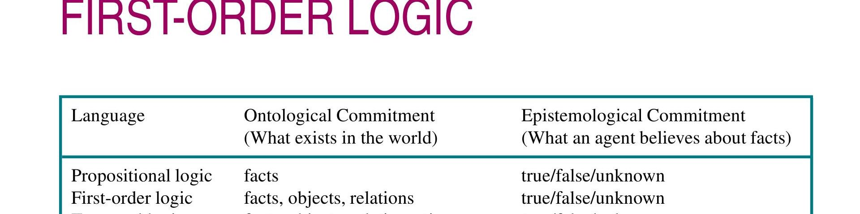
8.1 REPRESENTATION REVISITED
Ontological vs. epistemological commitments
Ontological = what exists
Epistemological = what an agent can believe
FOL keeps true/false/unknown like propositional logic, but upgrades its ontology to include objects and relations, not just bare facts.
i
ANALOGY
Think of ontology as the cast list of a play (who and what can appear on stage — people, props, relationships) and epistemology as the audience's certainty about the plot (do we know for sure who the killer is, or just suspect it?). Propositional logic has a cast of one type of thing: bare facts. First-order logic gives the cast real characters — objects — who can have relationships with each other, while the audience's knowledge can still be true, false, or unknown.
5

Slide 6
8.1 REPRESENTATION REVISITED
A good language is compositional
In a compositional language, the meaning of a sentence is built from the meaning of its parts.
S_{1,4} means “stench in [1,4]” and S_{1,2} means “stench in [1,2]” — so S_{1,4} ∧ S_{1,2} simply means both are true. It would be bizarre if it suddenly meant “France and Poland drew 1–1 in hockey.”
i
ANALOGY
Compositionality is why LEGO bricks work: a red 2x4 brick always means the same thing wherever you snap it in, and a model's meaning is just the sum of its bricks' known shapes. A non-compositional “language” would be like a LEGO set where the same brick sometimes builds a wheel and sometimes builds a random unrelated sentence about hockey — you could never predict what a combination means.
Why it matters: natural language is expressive, but ambiguous and context-dependent (“Look!” means nothing without shared context). FOL keeps English's descriptive power while staying precise and compositional.
6

Slide 7
8.2
SECTION 8.2
Syntax & Semantics of First-Order Logic
Objects, relations, and functions become first-class citizens. We'll build up the language piece by piece: models, symbols, terms, sentences, and quantifiers.
7

Slide 8
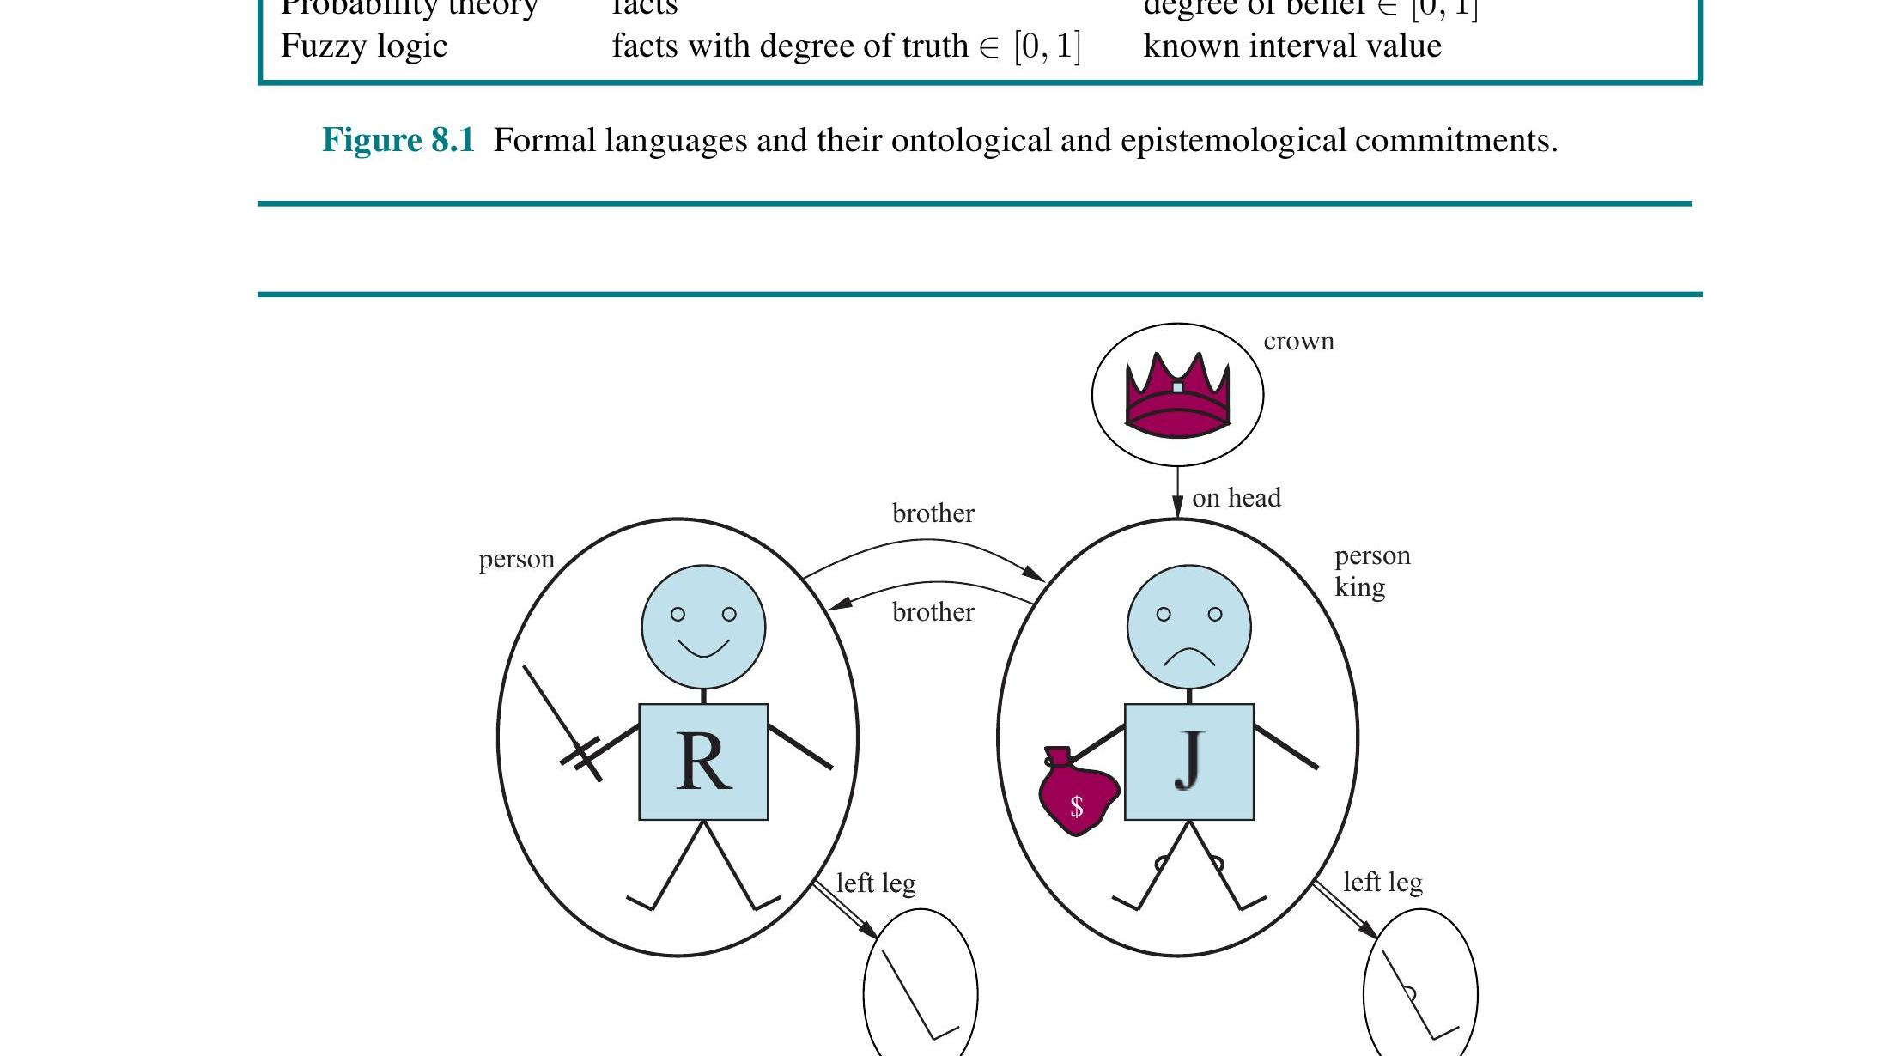
8.2.1 MODELS FOR FIRST-ORDER LOGIC
A model is a possible world of objects
Five objects in this world:
Richard & John person objects (unary relation)
a crown unary relation ‘Crown’
two left legs outputs of the LeftLeg function
brother / on-head binary relations linking objects
A relation is just a set of tuples of related objects — e.g. Brother = {⟨Richard,John⟩, ⟨John,Richard⟩}. A function maps each input to exactly one output (everyone has exactly one left leg).
8

Slide 9
8.2.2 SYMBOLS AND INTERPRETATIONS
Three kinds of symbols
1
2
3
CONSTANT
PREDICATE
FUNCTION
Richard, John
Brother, King, OnHead
LeftLeg(x)
Names a single object
Names a relation among objects
Maps an object to exactly one related object
i
ANALOGY
It's basic grammar, translated: constants are proper nouns (“John”), predicates are verbs or adjectives that connect nouns (“___ is brother of ___”), and functions are possessive phrases that name something new without giving it its own proper noun (“John's left leg” instead of inventing a name for that leg).
9

Slide 10
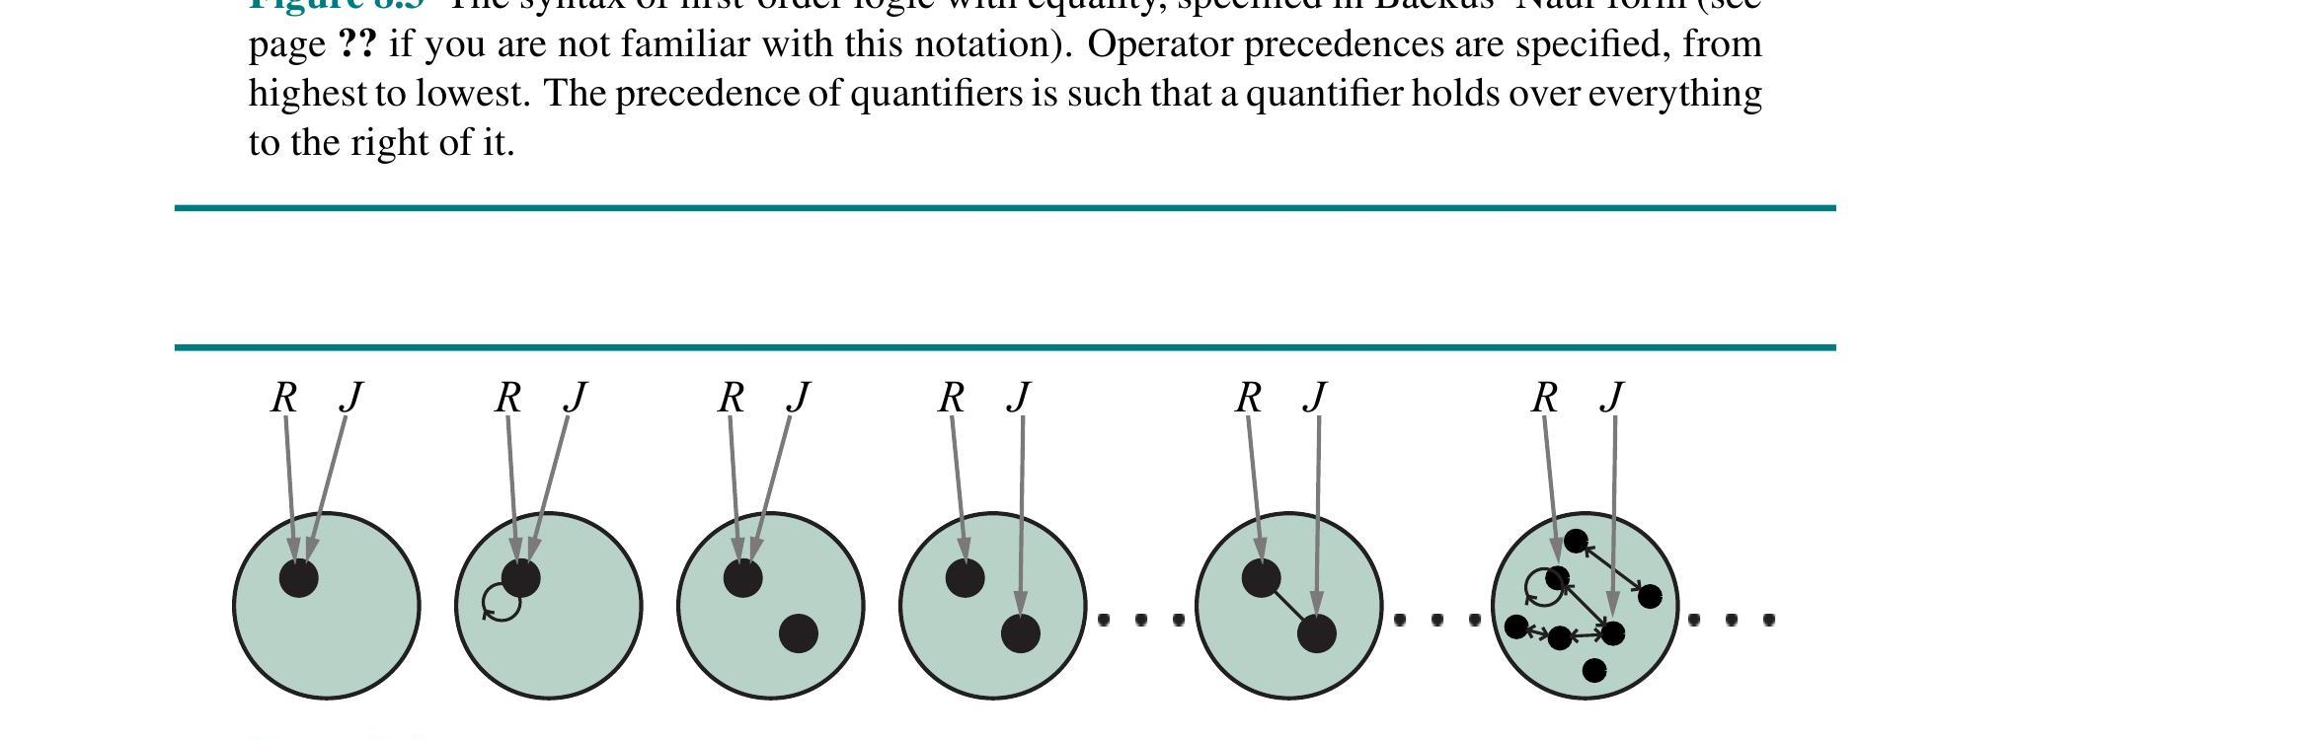
8.2.2 SYMBOLS AND INTERPRETATIONS
One vocabulary, many possible worlds
An interpretation fixes:
Which object each constant names
Which tuples each predicate holds for
Which mapping each function computes
Not every object needs a name, and one object can even have two names — the knowledge base's job is to rule out the interpretations that contradict what we know.
Same two constants (R, J) and one relation — but each model wires the arrows differently. With 6 or fewer objects, there are already 137,506,194,466 possible models.
10

Slide 11
8.2.3 TERMS
Terms: naming an object without a name tag
LeftLeg(John) refers to King John's left leg — without inventing a brand-new constant symbol for it.
Important: LeftLeg is not a subroutine that “runs” and “returns a value.” It's just a complicated name. We can reason about it (“everyone has a left leg”) without ever defining it computationally.
i
ANALOGY
This is exactly how we talk about people we haven't formally named: “my mom's coworker” or “the winner of last year's tournament”. You don't need to know their proper name to refer to them precisely and reason about them (“my mom's coworker probably drives to the same office”) — the description itself pins down exactly one person, the same way LeftLeg(John) pins down exactly one leg.
A term with no variables at all is called a ground term (e.g. LeftLeg(John)). A variable, like x, is itself a term — so LeftLeg(x) is also valid.
11

Slide 12
8.2.4 ATOMIC SENTENCES
Atomic sentences: the smallest true/false claims
Brother(Richard, John)
i
ANALOGY
An atomic sentence is a single, minimal claim on a form — like one checkbox on a census form: “Person A is related to Person B as: [ ] sibling.” You can't split it into smaller true/false pieces; it's either checked or it isn't. Sentences get complicated later by combining many of these single checkboxes together.
“Richard the Lionheart is the brother of King John.”
Married(Father(Richard), Mother(John))
Complex terms can be arguments too — “Richard's father is married to John's mother.”
An atomic sentence is true exactly when the relation holds among the objects the terms refer to.
12

Slide 13
8.2.5 COMPLEX SENTENCES
Same connectives, richer building blocks
¬Brother(LeftLeg(Richard), John)
Richard's left leg is not John's brother
Brother(Richard,John) ∧ Brother(John,Richard)
Both directions of the sibling relation hold
King(Richard) ∨ King(John)
At least one of them is king
¬King(Richard) ⇒ King(John)
If Richard isn't king, then John is
Connectives (¬ ∧ ∨ ⇒ ⇔) keep the exact same syntax and semantics as propositional logic — only the atoms underneath got richer.
13

Slide 14
8.2.6 QUANTIFIERS
Universal quantification: ∀ — “for all”
∀x King(x) ⇒ Person(x)
Watch the connective:
∀ pairs naturally with ⇒. Using ∧ instead would force EVERY object to be both a king AND a person — far too strong a claim.
“For every x, if x is a king, then x is a person.”
Formally true when King(x)⇒Person(x) holds under every possible extended interpretation of x — checked against every object in the domain.
∀x King(x) ∧ Person(x) ✗ (too strong)
i
ANALOGY
∀ is a building inspector who checks every single locker in the school, one after another, and confirms each one has a lock. Miss even one open locker, and the universal claim “every locker is locked” is false. That's why it pairs with ⇒: for lockers that turn out not to be lockers at all (say, a supply closet), the rule just doesn't apply to them — it doesn't force them to also be locked.
14

Slide 15
8.2.6 QUANTIFIERS
Existential quantification: ∃ — “there exists”
∃x Crown(x) ∧ OnHead(x,John)
Watch the connective:
∃ pairs naturally with ∧. Using ⇒ instead makes the claim almost meaningless — any object that simply isn't a crown satisfies it.
“There is some x that is a crown and is on John's head.”
True as soon as at least one extended interpretation of x makes the sentence true — doesn't rule out John wearing two crowns.
∃x Crown(x) ⇒ OnHead(x,John) ✗ (too weak)
i
ANALOGY
∃ is a metal detector sweeping a beach for a lost ring: it only needs to beep once, over one patch of sand, to prove “somewhere on this beach, there is metal.” It pairs with ∧ because you need both conditions true together at that one spot (metal AND in the sand) — not “if this patch has metal then...”, which would let every empty patch of sand “prove” the claim by simply not having metal.
15

Slide 16
8.2.6 QUANTIFIERS
Order matters: everybody loves somebody ≠ someone loved by everybody
∀x ∃y Loves(x,y)
∃y ∀x Loves(x,y)
“Everyone loves somebody” — each person can love a different person.
“Someone is loved by everybody” — one single person, loved by all.
A
B
C
A
B
★
C
Alice
Bob
Cara
Alice
Bob
Cara
Each arrow can point anywhere — loved ones can differ per person.
All three arrows converge on one single person.
i
ANALOGY
“Every kid has a favorite teacher” (different kids, different teachers) vs. “there is one teacher who is every kid's favorite” (one beloved teacher, shared by all). Same words, wildly different claim — the order you read the quantifiers in changes everything.
16

Slide 17
8.2.6 QUANTIFIERS
∀ and ∃ are mirror images, through negation
De Morgan's rules for quantifiers
∀x ¬Likes(x,Parsnips) ≡ ¬∃x Likes(x,Parsnips)
¬∃x P ≡ ∀x ¬P
“Everyone dislikes parsnips” = “no one likes parsnips.”
¬∀x P ≡ ∃x ¬P
∀x P ≡ ¬∃x ¬P
Variable scope: in ∀x(Crown(x) ∨ ∃x Brother(Richard,x)), the inner x belongs to the nearest ∃ — never reuse a variable name across nested quantifiers.
∃x P ≡ ¬∀x ¬P
i
ANALOGY
Exactly like ¬(P∨Q)≡¬P∧¬Q from propositional logic — ∀ behaves like a giant ∧ over all objects, and ∃ like a giant ∨.
“Nobody in the office likes Mondays” and “there doesn't exist a person in the office who likes Mondays” are the same statement said two ways — exactly how ∀ and ∃ trade places under negation.
17

Slide 18
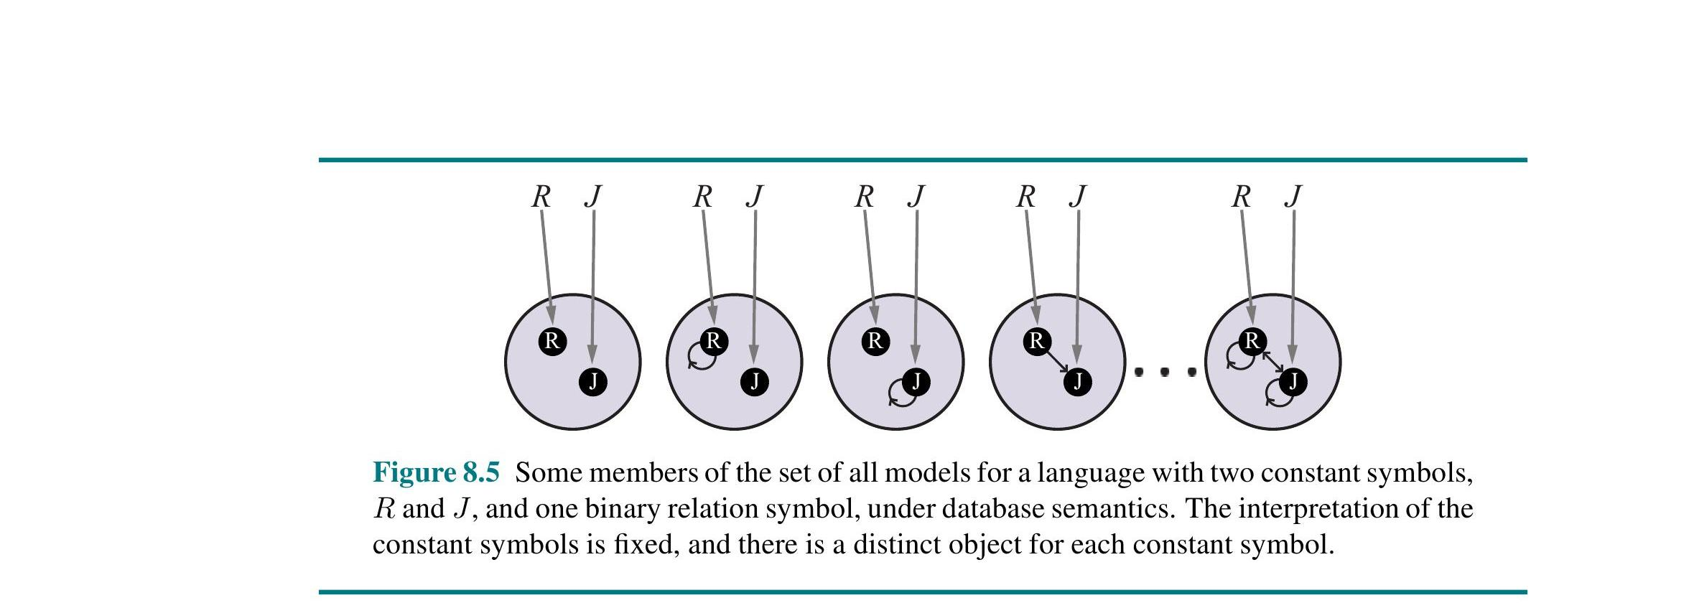
8.2.8 DATABASE SEMANTICS
When “the list is the whole truth”
Three assumptions:
Unique names: every constant names a different object
Closed-world: unstated atomic facts are false
Domain closure: no objects beyond the named ones
Only 16 possible models exist here (vs. infinitely many under standard FOL) — because names and objects are locked together.
i
ANALOGY
Standard FOL semantics is like an open casting call — saying “John and Geoffrey are Richard's brothers” doesn't rule out a third, unnamed brother showing up later. Database semantics is a final class roster: if a name isn't printed on the sheet, that person isn't in the room, and every name on the sheet is a distinct, separate student. That's why a SQL query can confidently say “no rows found” instead of “unknown.”
18

Slide 19
APPLYING FOL
Case in point: compressing the Wumpus World
Propositional logic (one rule per square):
i
ANALOGY
B₁ⱼ₁ ⇔ (P₁ⱼ₂ ∨ P₂ⱼ₁)
B₁ⱼ₂ ⇔ (P₁ⱼ₁ ∨ P₁ⱼ₃ ∨ P₂ⱼ₂)
B₁ⱼ₃ ⇔ (P₁ⱼ₂ ∨ P₁ⱼ₄ ∨ P₂ⱼ₃)
...
It's the difference between a hotel posting a separate handwritten sign on every single door (“no smoking,” repeated 400 times) and one policy printed in the welcome folder: “No smoking within 10 feet of any door.” One general policy, backed by a notion of ‘adjacent,’ covers every room the hotel will ever build — including wings that don't exist yet.
On a 100×100 grid: 10,000 separate rules.
First-order logic (one rule, ever):
∀s Breezy(s) ⇔ ∃p (Pit(p) ∧ Adjacent(p,s))
Same rule holds no matter how big the grid gets.
19

Slide 20
8.4
SECTION 8.4
Knowledge Engineering in First-Order Logic
Turning a real domain into working FOL axioms is a craft with its own process. We'll walk the 7 steps using a hands-on case study: a one-bit digital adder circuit.
20

Slide 21
8.4.1 THE KNOWLEDGE ENGINEERING PROCESS
Seven steps, every project
1
Identify the questions the KB must answer
5
Encode the specific problem instance
2
Assemble the relevant domain knowledge
6
Pose queries to the inference procedure
3
Decide on a vocabulary (the ontology)
7
Debug and evaluate the knowledge base
4
Encode general knowledge as axioms
i
ANALOGY
This mirrors how you'd write documentation for a new codebase you've inherited: first figure out what questions people will actually ask, gather knowledge from whoever understands it, settle on consistent terminology, write down the rules, plug in real examples, test with sample queries, and finally hunt down the bugs the tests reveal. Step 3 (vocabulary) is the make-or-break step — just like naming conventions can make or break a codebase's readability.
21

Slide 22
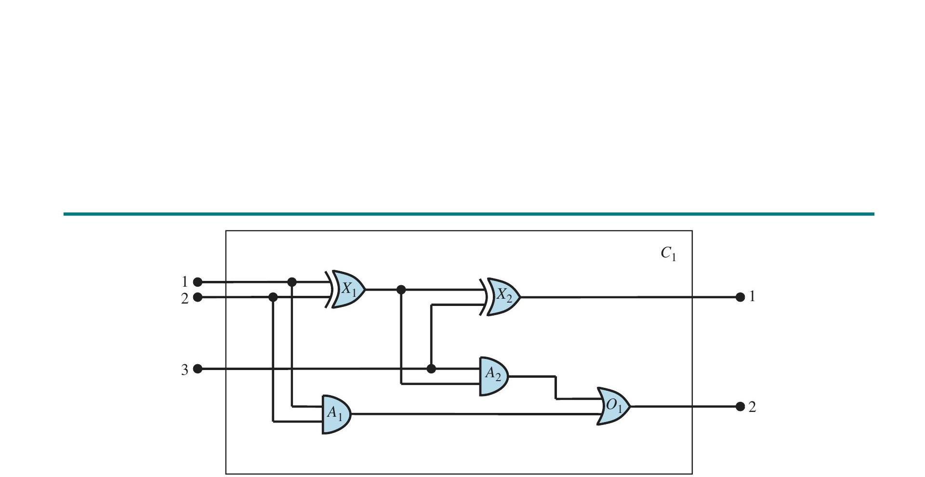
8.4.2 THE ELECTRONIC CIRCUITS DOMAIN
Case study: a one-bit full adder
Circuit C₁ has:
3 inputs two bits to add, plus a carry-in
2 outputs the sum bit, and a carry-out bit
5 gates two XOR, two AND, one OR
Question we want the KB to answer: does this circuit actually add correctly? What are all the gates connected to the first input? Does it contain feedback loops?
22

Slide 23
8.4.2 VOCABULARY
Building the ontology: gates, terminals, signals
Gate(x)
Type(g) = XOR
x is a logic gate
a gate's behavior type
Terminal(x)
In(1,X₁) / Out(n,c)
x is an input or output pin
the n-th input/output terminal
Connected(t₁,t₂)
Signal(t)
two terminals are wired together
the value (1 or 0) at terminal t
i
ANALOGY
This is exactly how you'd design a database schema for the circuit: tables for Gate and Terminal, a Type column, a Connected join-table linking terminal pairs, and a Signal column holding each terminal's current value — good ontology design is good schema design.
23

Slide 24
8.4.2 ENCODING GENERAL KNOWLEDGE
A handful of axioms describe every gate
Connected terminals share a signal:
Full adder truth table
Connected(t₁,t₂) ⇒ Signal(t₁)=Signal(t₂)
A
B
Cin
Sum
Carry
0
0
0
0
0
AND is 0 iff any input is 0:
0
0
1
1
0
Signal(Out(1,g))=0 ⇔ ∃n Signal(In(n,g))=0
0
1
0
1
0
XOR is 1 iff inputs differ:
0
1
1
0
1
Signal(Out(1,g))=1 ⇔ Signal(In(1,g))≠Signal(In(2,g))
1
0
0
1
0
1
0
1
0
1
1
1
0
0
1
...plus rules fixing gate arity, forbidding mixed-up identities (gates ≠ terminals ≠ signals), and stating every gate is itself a circuit.
1
1
1
1
1
24

Slide 25
8.4.2 POSING QUERIES
Ask the KB, don't hand-simulate the circuit
Query: which inputs make the sum bit 0 and the carry bit 1?
∃i₁,i₂,i₃ Signal(In(1,C₁))=i₁ ∧ Signal(In(2,C₁))=i₂ ∧ Signal(In(3,C₁))=i₃ ∧ Signal(Out(1,C₁))=0 ∧ Signal(Out(2,C₁))=1
ASKVARS returns three substitutions: {1,1,0} {1,0,1} {0,1,1}
i
ANALOGY
This is like using a spreadsheet formula to auto-fill every row that satisfies a condition, instead of manually checking each of the 8 possible input combinations by hand. Once the axioms are right, asking a question and testing the whole circuit are the same act — that's circuit verification, for free.
A broader query — asking for every terminal's value at once — returns the full input–output table, confirming (or disproving) that the circuit really adds.
25

Slide 26
8.4.2 DEBUG AND EVALUATE
When the KB goes quiet: missing axioms
The bug
i
ANALOGY
Forget to assert 1 ≠ 0, and the KB can no longer prove most of the circuit's outputs — only the trivial all-0 and all-1 input cases still work.
It's like a legal contract that never states “east” and “west” can't be the same direction — the judge (inference engine) can't rule on any case that depends on that distinction, even though it seems too obvious to write down. Debugging a knowledge base is often less about wrong logic and more about unstated ‘obvious’ assumptions that were never actually written into the axioms.
How it's found
Query each gate's output directly. X₁'s output is unknown for inputs (1,0) — tracing the XOR axiom shows it reduces to “1 ≠ 0,” which was never stated.
Missing axioms halt reasoning silently; incorrect axioms produce confidently wrong answers — always test against a query suite, not just “no obvious errors.”
26

Slide 27
CHAPTER SUMMARY
Key takeaways
Good representation languages are declarative, compositional, expressive, and unambiguous.
1
FOL commits to objects and relations existing (ontological), while truth stays true/false/unknown (epistemological).
2
A model = a domain of objects + an interpretation mapping symbols to objects, relations, and functions.
3
∀ pairs with ⇒; ∃ pairs with ∧ — mixing them up over- or under-states the claim.
4
Quantifier order changes meaning; ∀ and ∃ trade places under negation (De Morgan for logic).
5
Knowledge engineering is a 7-step, iterative process — vocabulary choice is usually the hardest part.
6
27

Slide 28
QUICK REFERENCE
The analogy cheat sheet
Propositional → FOL
House-by-house code → one zoning law
Declarative vs. procedural
The finished dish vs. the recipe
Terms
“My mom's coworker” instead of a proper name
∀ (universal)
Inspector checking every locker
∃ (existential)
Metal detector needing one beep
Database semantics
A final, closed class roster
FOL rule compression
One hotel policy vs. 400 door signs
COMP 469 · Introduction to Artificial Intelligence · Chapter 8
28

